Slide 1

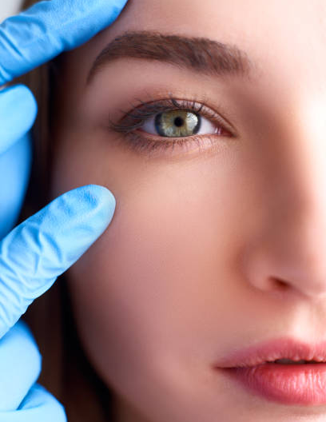




FUTURE
VISION
Driving Success at “I Love LASIK” through Enhanced Web Analytics and UI Optimization

Slide 2

01
02
Competitive Analysis: Navigating the LASIK Landscape
Visual Audit: Identifying UI Enhancements
Provides a comprehensive SWOT analysis and detailed examination of key competitors within the LASIK industry.
Focuses on evaluating the current website interface and identifying potential improvements.
CONTENTS
03
04
Social and Search Media Analysis: Optimizing Channels
KPIs: Setting the Standard for Web Analytics
Concentrates on reviewing the use of social and search media and suggesting effective strategies.
Discusses the selection of KPIs, calls to action, and settings to ensure accurate tracking of web analytics results.
05
Conclusive Insights: Evaluating Outcomes and Forward Strategies
Offers a synthesis of key findings and recommendations, outlining actionable strategies to enhance future performance based on evaluated outcomes.

Slide 3

01
Competitive Analysis: Navigating the LASIK Landscape

Slide 4
STRENGTHS | WEAKNESSES | OPPORTUNITIES | THREATS
Multiple locations in key areas of NYC 25 years experience in LASIK Eye Surgery Personalized care and LASIK Surgery Treatment Plans Latest and Safest Laser Eye Surgery technologies in New York | Visitors are not engaging with the site’s content. Short Visit Duration Over-reliance on Organic Search - lack of diversity in traffic sources. Keyword Strategy Potential high bounce rate | Create a dedicated community forum for users to connect and share experiences Partner with orgs like VISIONS and Sights on Health and offer exclusive resources Collaborate with influencers in the self-care, and wellness, spaces to promote the brand | Growth of competitors Increased demand for Colored Lenses Perception of treatment risk and lack of awareness due to its direct impact on vision. Economic downturn leading to decrease in demand.
S
W
O
T

Slide 5
Current Competititors
Manhattan LASIK Center
Lasik Vision Institute
TLC Lasik Eye Centre
Kelly Vision

Slide 6
Competitive Analysis
UI
Social Media
The UI for competitors appears to be straightforward and simple to navigate.
They have CTAs encouraging consumers to schedule consultations and use their services.
The competitors have active profiles on platforms like Instagram, and Twitter.
They post contents that includes LASIK-related educational blogs, surgeon spotlights, and practice updates.
Marketing Strategies
SEO
$100 Credits applied to procedure for first time user only
Use paid advertising on Google to target people interested in LASIK surgery
Offer Free Virtual Consultation
They rank top 5 when users search about LASIK surgery in NYC.
The competitors regularly release blog posts, FAQs, and videos to demonstrate knowledge and drive traffic

Slide 7
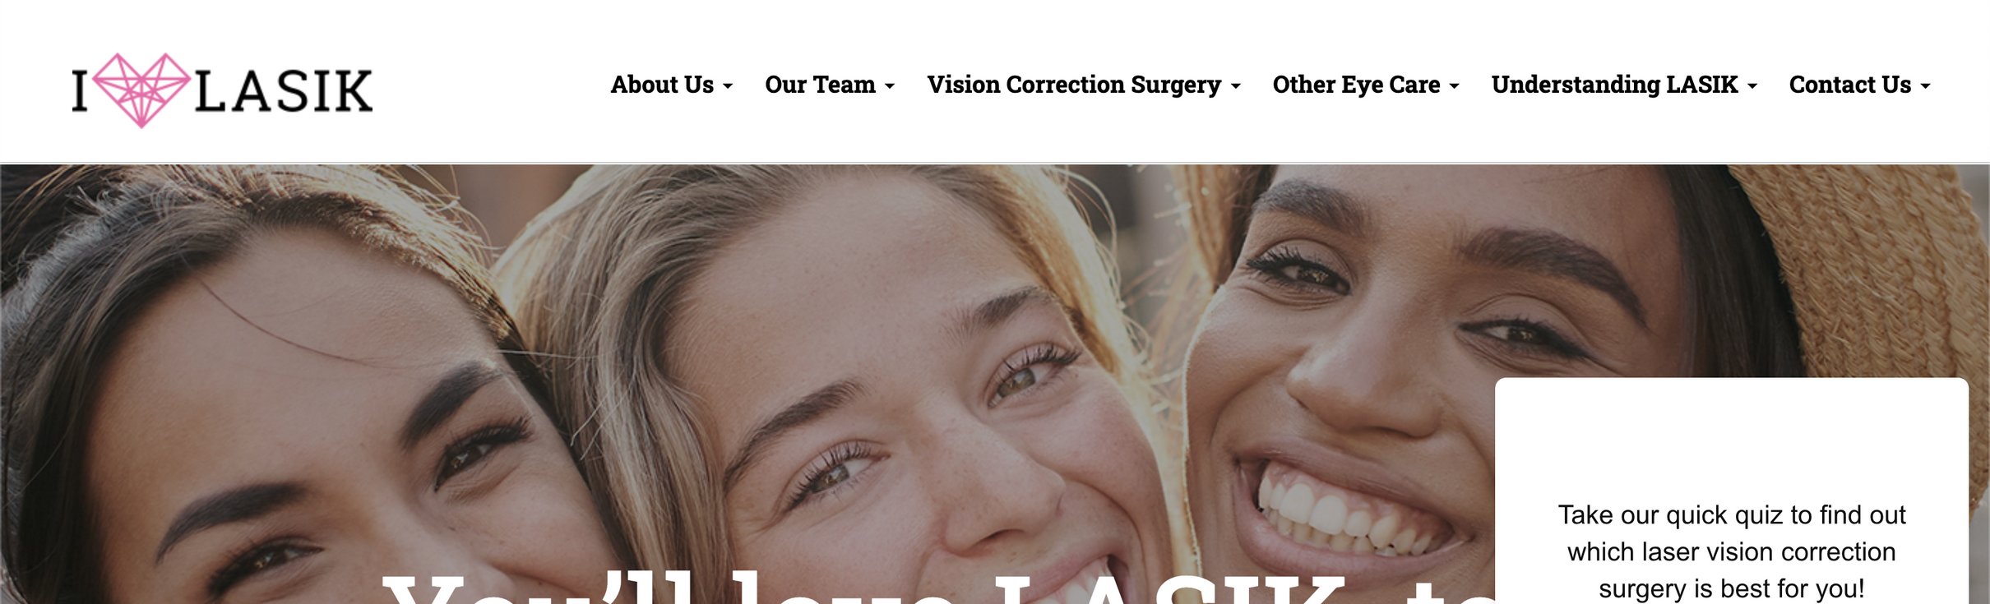
02
Visual Audit:
Identifying UI Enhancements

Slide 8
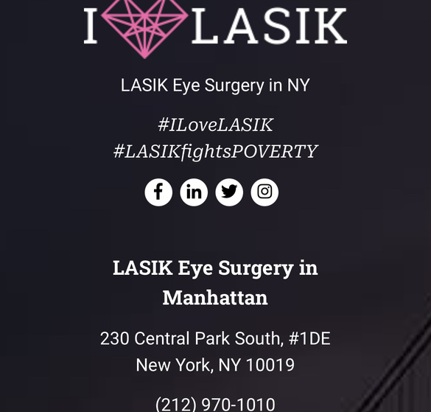

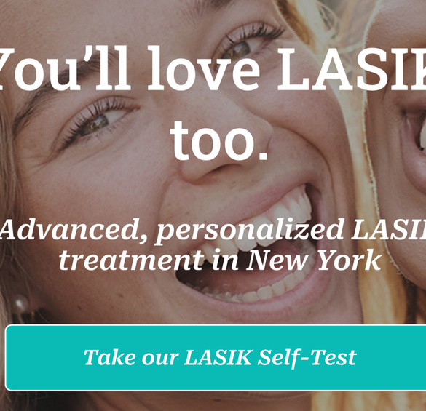
Potential Issues
Standardizing Typography
Layout & Imagery
Responsiveness
The usage of various fonts, font sizes and styles is inconsistent throughout the website, making it difficult to read and navigate. Standardizing them is essentially important.
The images are low in quality and not optimized for web use, causing slow loading times. They are also abruptly cut out in some places on the website.
The website is not fully responsive and doesn't adapt well to different screen sizes and devices. The menu is not responsive and disappears on smaller screens, making it hard to navigate on mobile devices.

Slide 9
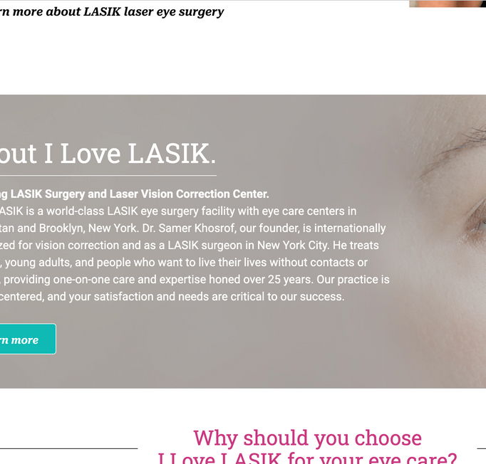
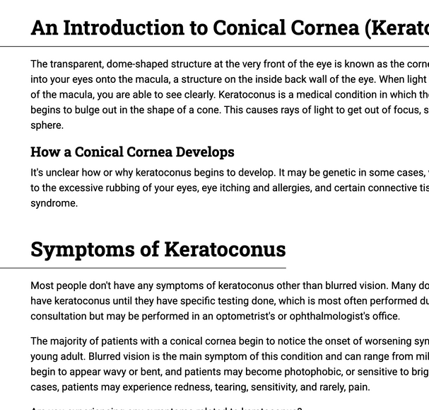
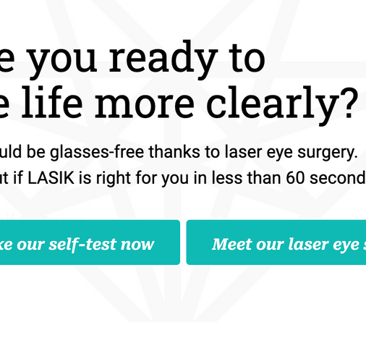
Potential Issues
Usage of Colours
Lack of Negative Space
CTAs don’t stand out
Using too many colours may be overwhelming and not appealing to all users. There is little usage of pink on the website except the logo.
The lack of negative space makes the website feel cramped and overwhelming. There are too many information buckets and very few visuals.
The website provides too much information but very few CTA buttons. The user does not know what to do next after reading the information.

Slide 10
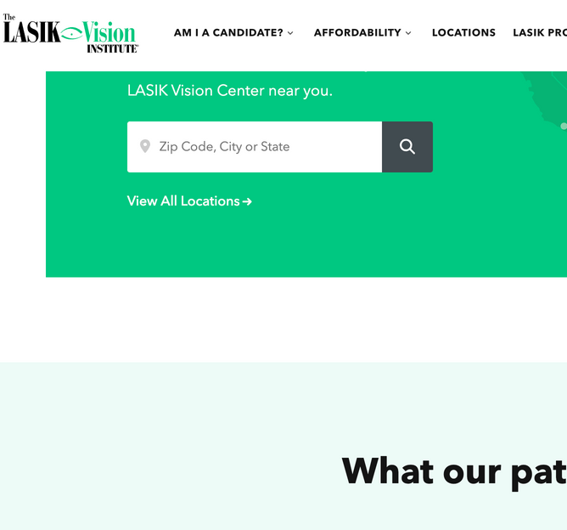
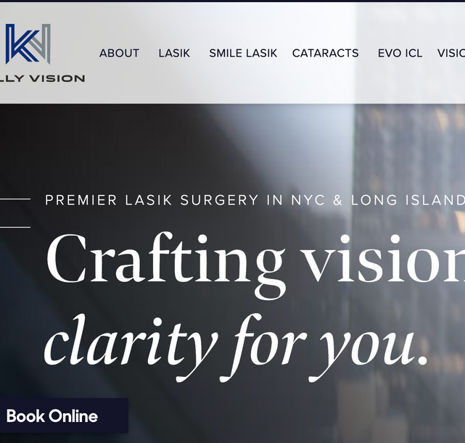
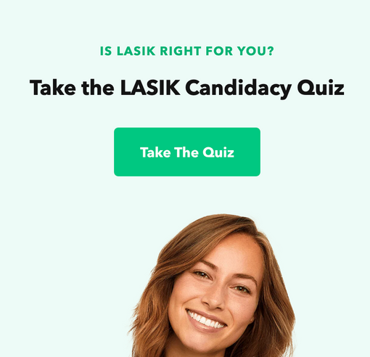
Areas of Improvement
Simplify Colour Scheme
Standardize Typography
Make CTAs prominent
Use a more muted and monochromatic colour scheme to improve readability and visual appeal. Eliminating a few colours will make it look cleaner and more cohesive.
Use 2 fonts and 2 styles at the most to make the website look more standardised.
Use click-bait and prominent CTAs to guide the users' actions.

Slide 11
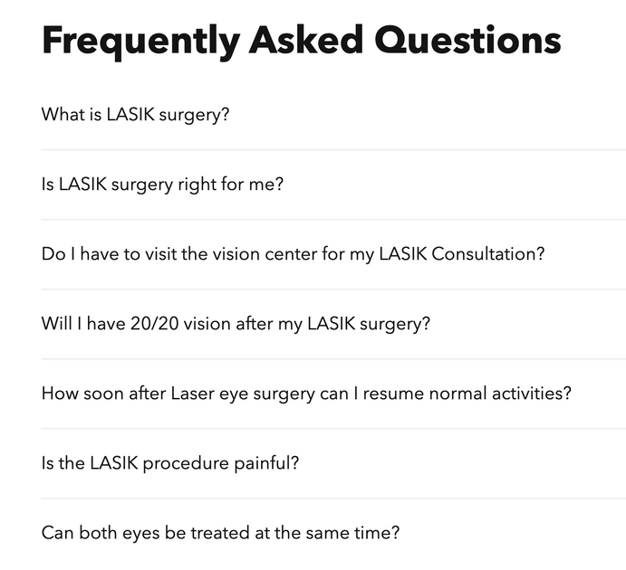
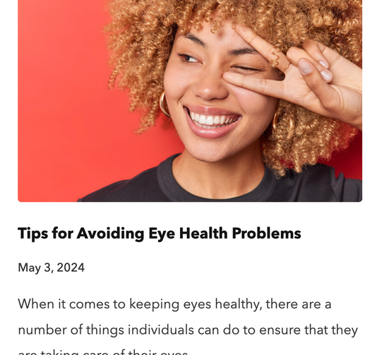
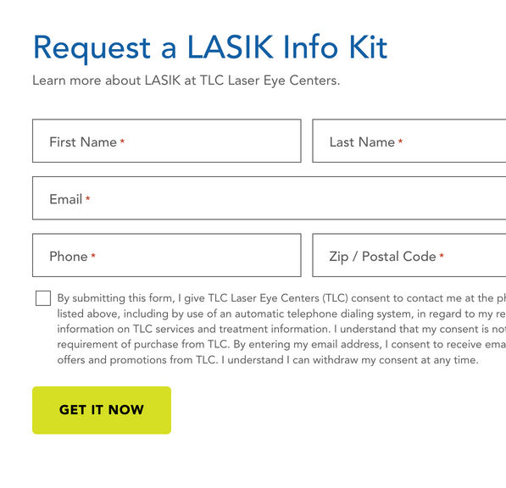
Areas of Improvement
Add an FAQ section
A dedicated blog
Generate a form
Add an FAQ section or an automated chatbot so users can get their questions answered online itself.
Create a dedicated blog section on the website for users to learn more about wellness, eye health, LASIK and much more.
Craft a form for e-book downloads, gathering details from interested clients for timely follow-up.

Slide 12
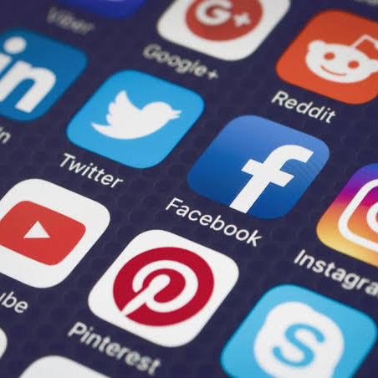
03
Social and Search Media Analysis: Optimizing Channels

Slide 13
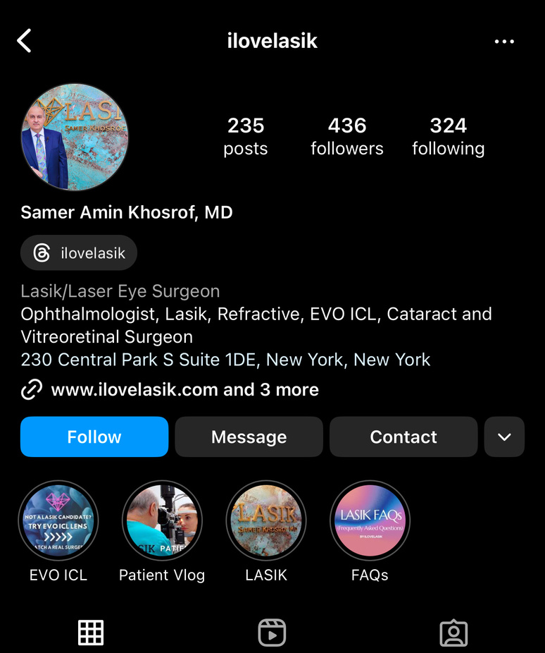


Social Media Analysis
Potential Issues
Lack of business’s logo
Lack of a LinkedIn Profile for the business
Reduces the clinic's visibility among industry peers and potential clients seeking services, authoritative content, and professional endorsements.
Suboptimal Social Media Engagement:
Lack of interactive and visual elements.
Lack of aesthetics.
Unclear brand Identity on Instagram
Create ambiguity whether the page represents the LASIK business or focuses solely on Dr. Samer Khosrof.
Lack of business’s name
IG’s name is ilovelasik but the description is about Dr. Khosroft

Slide 14
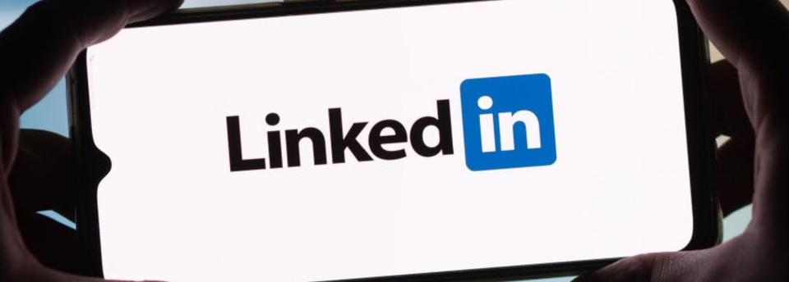
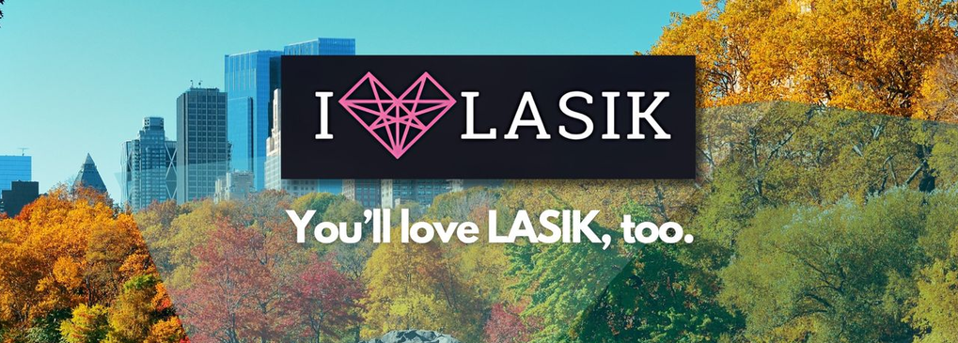

Areas of Improvement
Establish a LinkedIn Profile for I Love LASIK
Resolve Branding Ambiguity on Instagram
Create a comprehensive LinkedIn profile highlighting the clinic’s expertise, sharing authoritative content, and showcasing professional endorsements.
Need to make the name and the bio of the Instagram page aligned.
Create a separate instagram for Dr. Khosrof to increase personal branding.
Consistently utilize the business’s logo and visual branding elements across all social media platforms to ensure uniformity and enhance brand recognition.

Slide 15

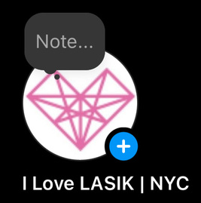
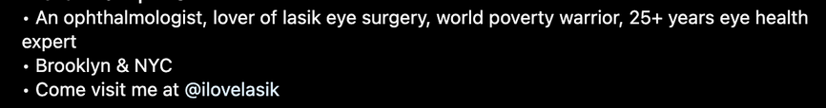
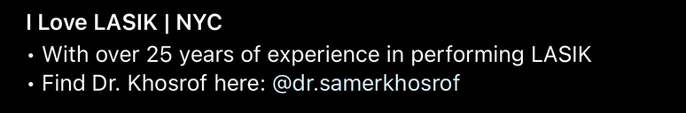
Areas of Improvement
Dr. Khosrof’s personal page
I Love LASIK’s page

Slide 16
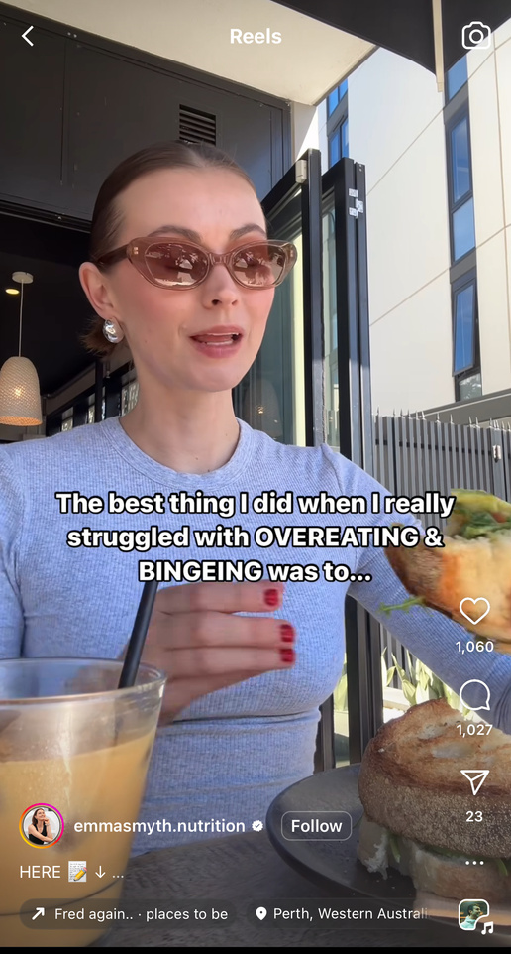
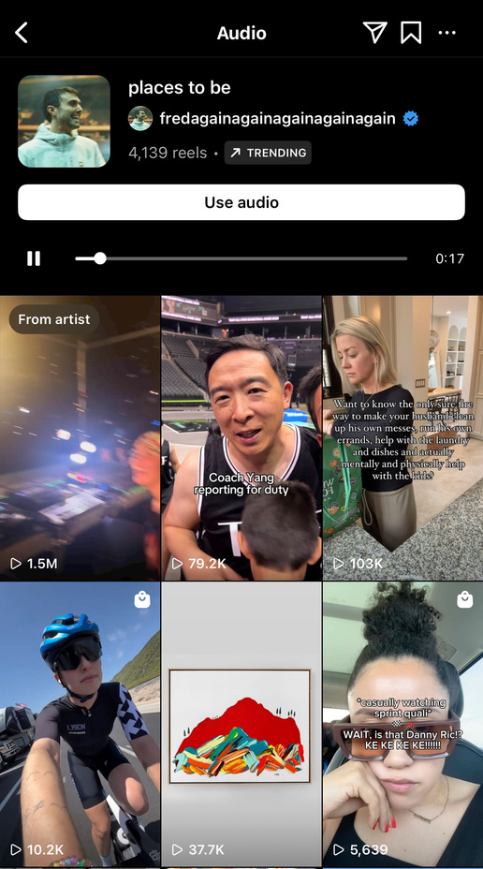
Areas of Improvement
Enhance engagement on Instagram
Utilize reels to attract audiences:
Use trending sounds on Instagram
Any sounds that have an arrow on the left bottom corner .
An ideal lengths : 5 - 8 seconds
Post content in the caption
Create reels with engaging hook:
“You need to hear this”
“I bet you didn’t know”
“Why is no one talking about …”
Posting time:
Weekdays: 7 am to 9 am
Weekends:
Saturday: 7 am to 9 am
Sunday: after 7pm
Click into the arrow to check if it is a trending sound
Look for sounds that have an arrow on the left bottom corner

Slide 17

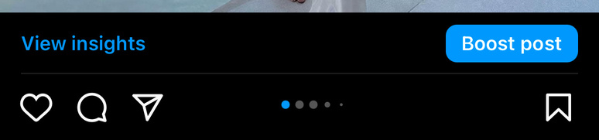
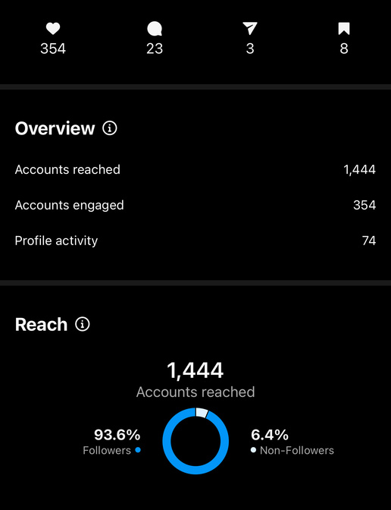
Enhance engagement on Instagram
Metric to Measure:
Follower Growth:
The increase of follower growth indicates the accounts doing well in attracting targeted audiences.
Traffic to Website
Tracking the number of clicks to website that is included in the bio can tell which accounts drive more potential clients.
Conversion Rates:
The higher the conversion rates = the higher % effectiveness of the accounts converting followers.
Engagement Rates:
The higher engagement rates (likes, comments, shares) = engaging and relevant contents.
This can help in tracking the content performance to see which content perform the best.
Audience Insights
Monitoring audience insights can help gather demographic and behavioral information about the followers of each account, ensuring that the content is customized to match the interests and requirements of each audience segment.
Click here to view audience insights
The Audience Insights shows numbers of likes, share, saved and overview information

Slide 18
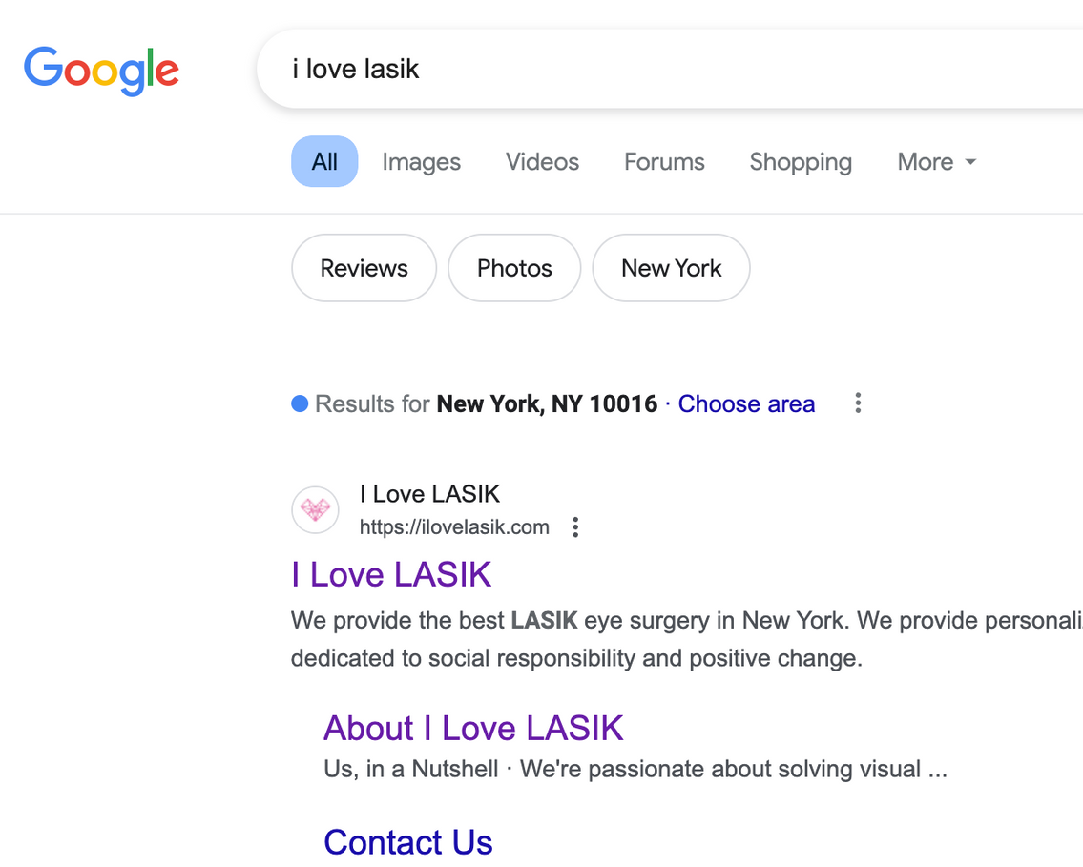

Search Media Analysis
Search Media Analysis
Potential Issues
Search Engine Optimization (SEO) Issues:
The "I Love LASIK" website consistently appears as the top search result when the brand name is specifically searched, demonstrating effective search engine optimization for its brand term.

Slide 19
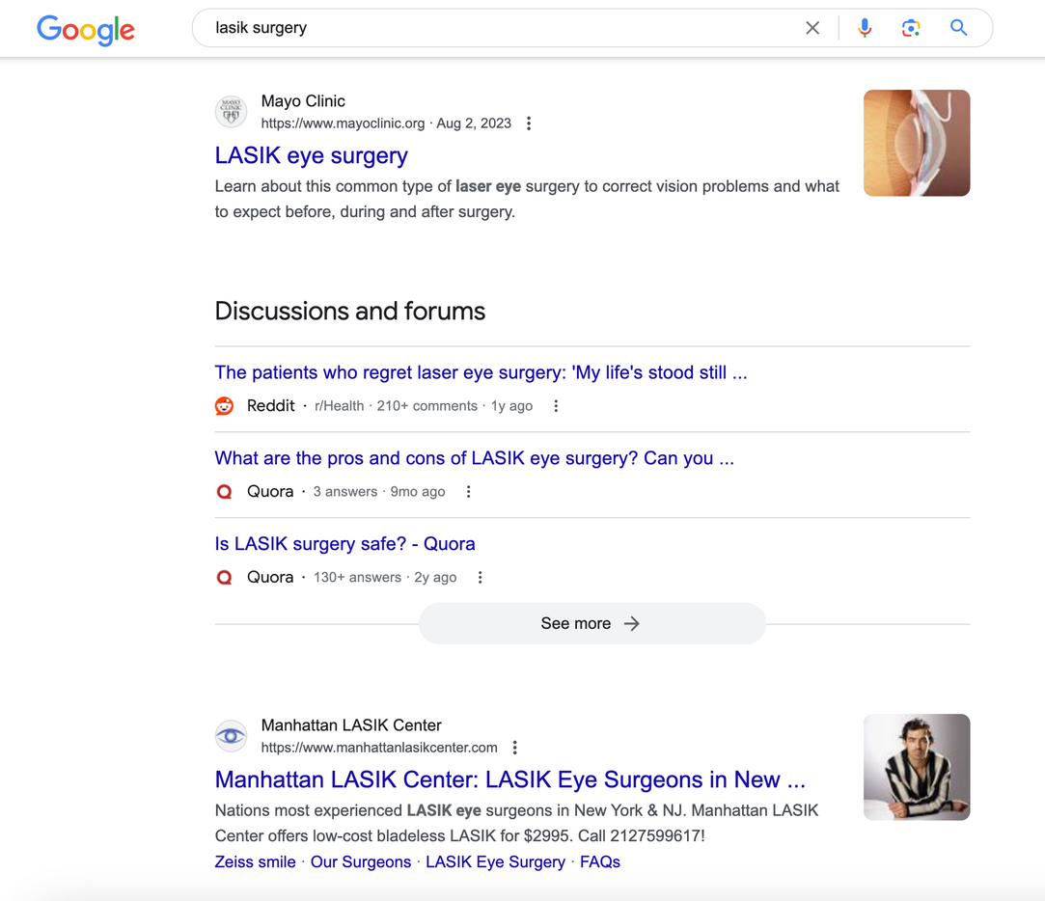
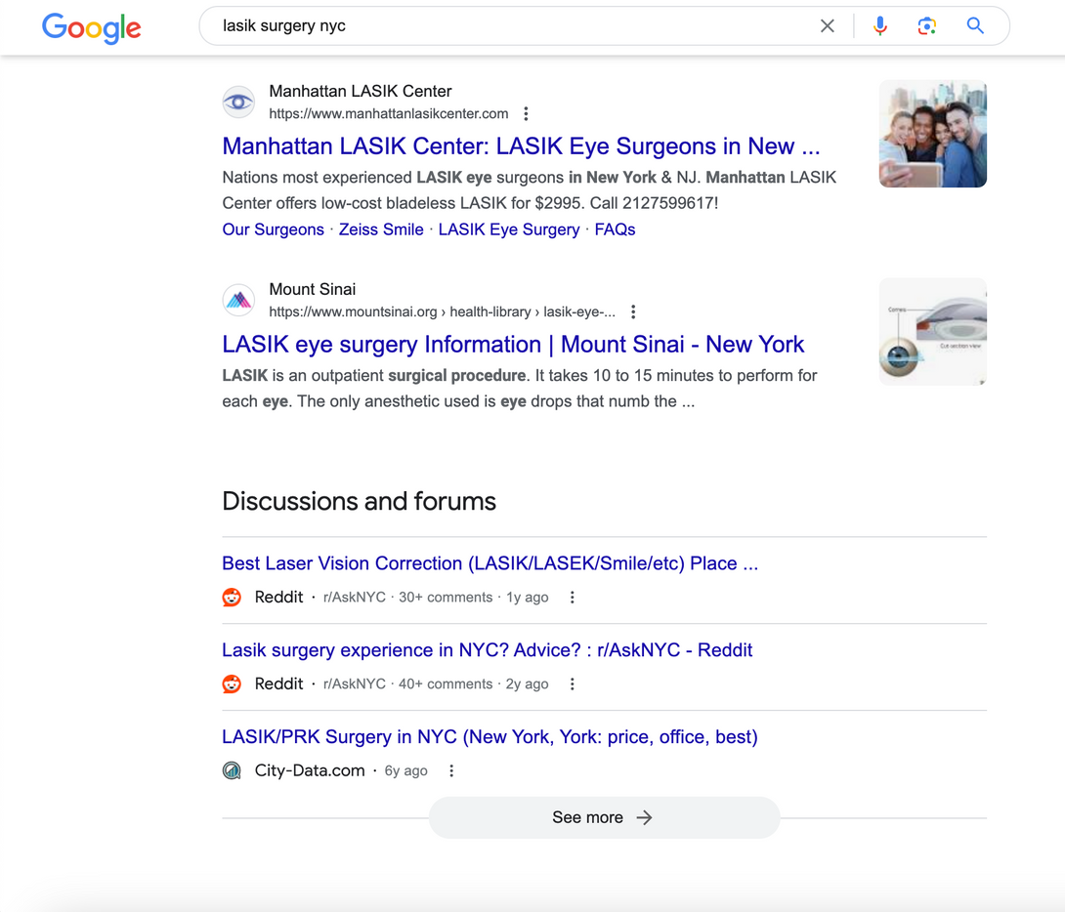
Search Media Analysis
Search Media Analysis
Potential Issues
However, the website does not rank top when various relevant keywords are searched, potentially limiting visibility to a broader audience.

Slide 20

Areas of Improvement
Improve Search Engine Optimizations (SEO)
Keyword Optimization:
Use more generic and high-impact LASIK-related keywords associated with Lasik, Lasik surgery, and eye care.
Step 1: Understand audience and goals
Looking for lasik surgery
Step 2: Brainstorms keywords
Start with broad terms that describe the services offered by I Love LASIK
"Lasik surgery," "vision correction," "eye surgery," and "Lasik procedure”.
Step 3: Expand them into long tails keywords
“Lasik surgery in nyc”, “Lasik surgery in Manhattan”, “Lasik surgery in Brooklyn”
“Lasik in NYC”, “Lasik in Manhattan”, “Lasik in Brooklyn”
“Lasik surgery near me”, “Lasik procedure near me”
“affordable Lasik surgery”, “best Lasik surgeon in NYC/Brooklyn”.

Slide 21
Search Engine Optimizations
Metric to Measure:
Organic traffic:
An increase in organic traffics suggest effective SEO keywords strategies.
Keyword rankings
Track how well the website ranks for both the broad like "Lasik surgery" and long-tail keywords like "Lasik surgery in NYC."
The higher the ranking = the more visibility leading to an increase in organic traffic.
Click through rate (CTR)
The higher CTR = the higher % of users who click on the website link after seeing it in the search result.
Bounce rate
The lower the bounce rate = the smaller % who leave the website after only viewing only one page.
Conversation rate
The higher the conversion rate = the higher number of visitors visiting the website from organic search results completed an action.
This could be measured through tracking calls, appointment bookings, or information requests.
Time on page
The higher the time on page = the higher average time visitors spend on the website --> engaging and relevant content
Page per session
The higher the page per session = the higher average number of pages a visitor views during a session --> engaging and relevant content

Slide 22
Maximize Social Media
Strategic partnerships with influencers
1
Find high-engagement influencers interested in complimentary LASIK surgery in exchange for social media content creation.
2
Reach out to selected influencers to gauge interest and negotiate terms of collaboration. They should be influential in health, lifestyle, beauty, or local community sectors with strong and positive social media presence and high engagement rate (likes, comments, shares).
3
Provide influencers with complimentary LASIK surgery and guidelines for content creation ((key messages, relevant hashtags, appropriate tagging protocols, and any necessary compliance requirements).
4
Encourage influencers to create engaging content showcasing their LASIK experience and tag I Love LASIK on social media platforms.
Amplify visibility by reposting influencer-generated content on I Love LASIK's social media channels and engaging with audience feedback and actively responding to questions and comments on both the influencer’s and clinic’s posts to foster engagement.
5
6
Incentivize engagement by offering 5-10% commission for referrals made under influencers' names, further motivating them to promote the clinic and drive conversions.

Slide 23
Strategic partnerships with influencers
Metric to Measure:
Interaction levels on influencers’ posts (engagement rates)
Traffic to the clinic’s website from influencer links.
Conversion rates from potential client inquiries to actual surgeries performed.
TOTAL ESTIMATED BUDGET
Budget (3 influencers)
Complimentary Surgeries: $6,000
Influencer Fees: $10,500
Referral Commissions: $600
=> TOTAL: $22,500
Set aside a budget for complimentary surgeries, payment for influencers, and possible referral commissions.
Cost per Surgery:
Assume the cost of each LASIK surgery is about $2,000.
Total cost for 3: 3 x $2,000 = $6,000.
Influencer Fees
Mid-tier influencers: ~$1,000 to $5,000/ influencer.
Total cost for 3: 3 x average $3500 = $10,500
Referral Commissions
Commission Rate: 5-10%
Estimated Revenue per Referral:$200 per booking for 10% commission
Estimated Number of Referrals: $200 x 3 influencers = $600 for 10 referrals

Slide 24
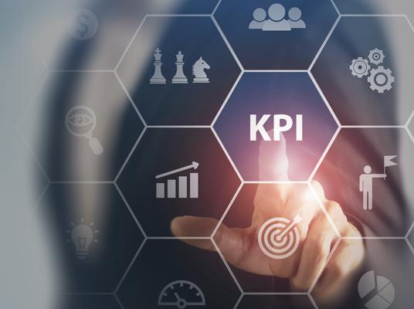
04
KPIs: Setting the Standard for Web Analytics

Slide 25



Potential Growth
KPI: Increase in organic search traffic from local users.
KPI: Growth in website traffic and engagement
Call-to-Action (CTA):
Call-to-Action (CTA):
Find Our Nearest Clinic
Download Our LASIK Success Stories eBook
Directing users to a page showcasing the nearest clinic locations.
Floodlight Settings: Implement conversion tracking for clicks to measure engagement and conversions from local users actively seeking LASIK services.
Encouraging visitors to download an eBook featuring real success stories from previous patients.
Floodlight Settings: Set up event tracking for eBook downloads to measure the effectiveness of the content marketing campaign.
est. +15%
est. +20%
est. +10%
increase in organic local traffic
increase in website traffic
increase in engagement metric

Slide 26

Potential Growth
KPI: Increase in referral traffic and conversions.
Call-to-Action (CTA):
Refer a Friend, Both Get $100 Off LASIK!
Incentivizing existing patients to refer friends and family.
Floodlight Settings: Implement cross-domain tracking to accurately attribute conversions from referral sources.
est. +25%
est. +20%
increase in referral traffic
increase in conversions from referral sources

Slide 27

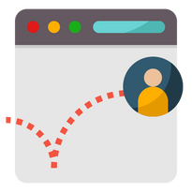

Potential Issue Resolutions
High Bounce Rate on LASIK Quiz Page
Low Conversion Rate on Quote Request Form
NEW Call-to-Action (CTA):
NEW Call-to-Action (CTA):
Speak with Our LASIK Experts
Schedule Your Free Consultation Now!
Offering a live chat option for visitors who may have questions or concerns while taking the quiz.
Floodlight Settings: Set up event tracking for live chat interactions to measure engagement and identify areas for improvement.
Emphasizing the value of scheduling a consultation with Dr. Samer Khosrof.
Floodlight Settings: Implement enhanced e-commerce tracking to track quote requests as conversions accurately.
est. -10%
est. +10%
decrease in bounce rate on LASIK quiz
increase in conversion rate for quote requests

Slide 28

Potential Issue Resolutions
Lack of Engagement with LASIK Guide
NEW Call-to-Action (CTA):
Get Personalized LASIK Recommendations
Offering visitors the option to receive personalized LASIK recommendations based on their unique needs and preferences.
Floodlight Settings: Set up event tracking for interactions with the personalized LASIK recommendations feature.
est. +15%
increase in engagement with LASIK informational guide

Slide 29
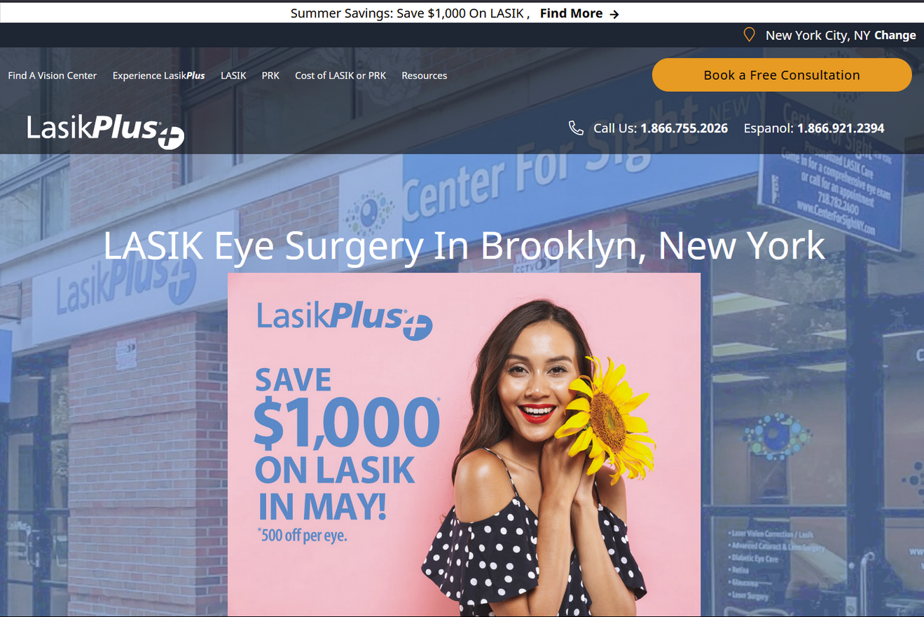
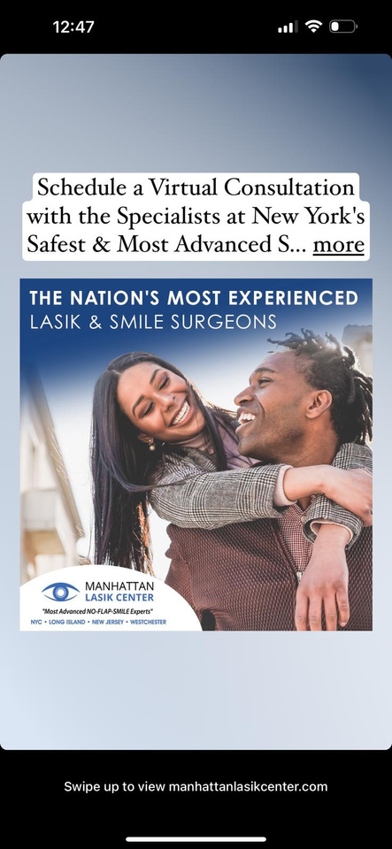
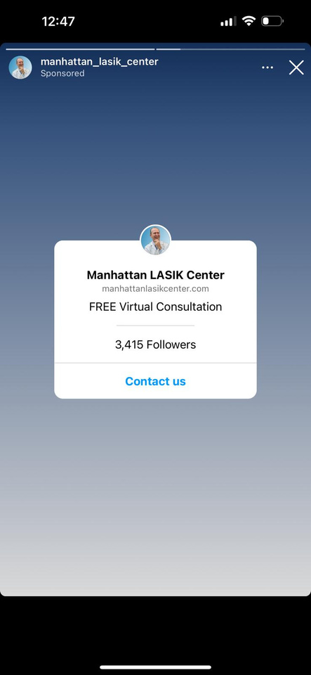
Competitor’s Comparision

Slide 30
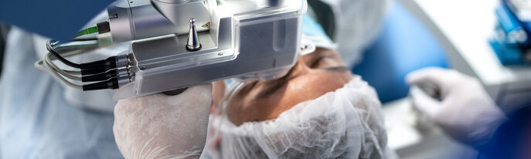
05
Strategic Marketing Initiatives: Expanding Reach and Engagement

Slide 31
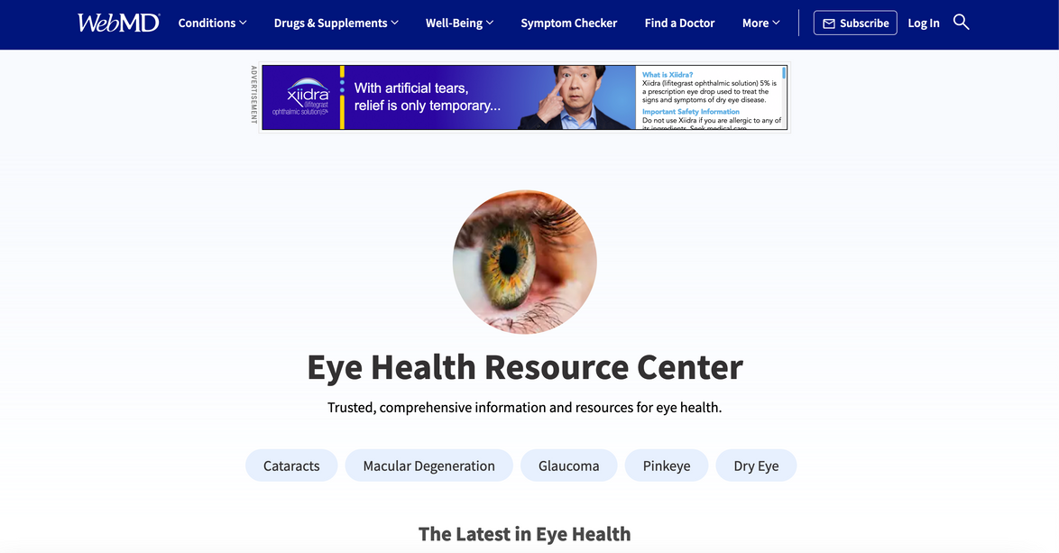
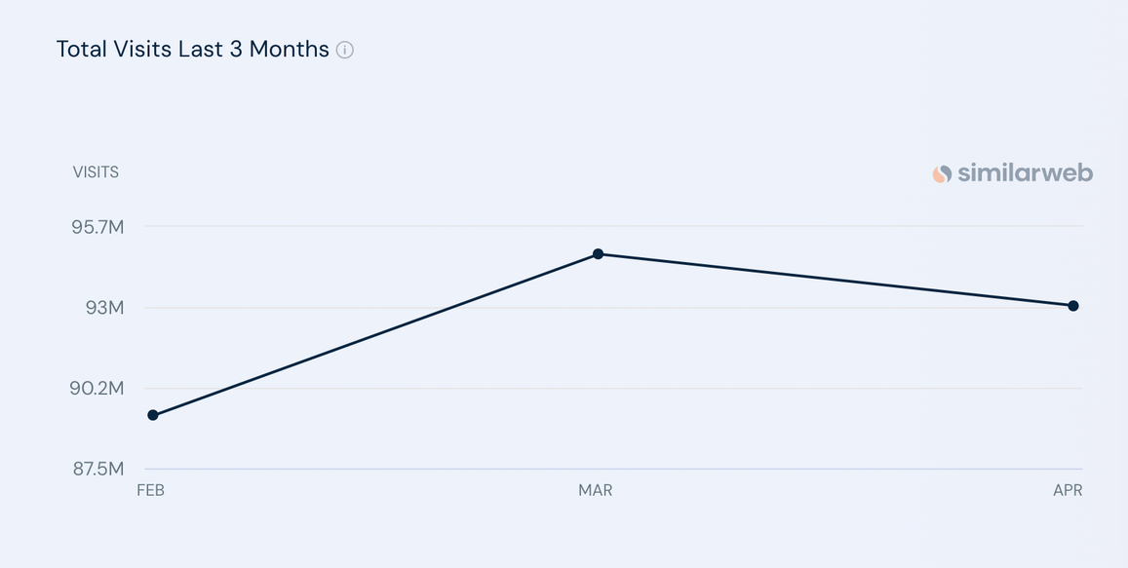
WebMD
a well-known health information website that provides valuable resources for individuals seeking medical information, advice, and support.
Average Visits Per Month = 92.37M
source: similarweb

Slide 32
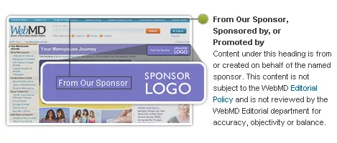
Sponsoring Ads on WebMD
Objectives
Increasing awareness of LASIK
Attracting people to consult
Driving traffic to website
Ad Placement
Target placements on WebMD's pages related to eye health, vision correction, or LASIK surgery
Target Audience
source: WedMD
Target individuals interested in eye health, vision correction, or those actively seeking information about LASIK surgery

Slide 33
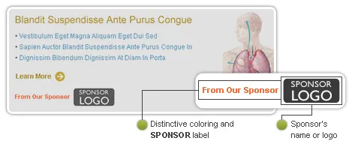
Sponsoring Ads on WebMD
Links to sponsor content
Campaign Duration
1 to 3 months (to assess performance and make necessary adjustments)
Budget Allocation
source: WedMD
Monthly budget ranging from $5,000 to $20,000

Slide 34
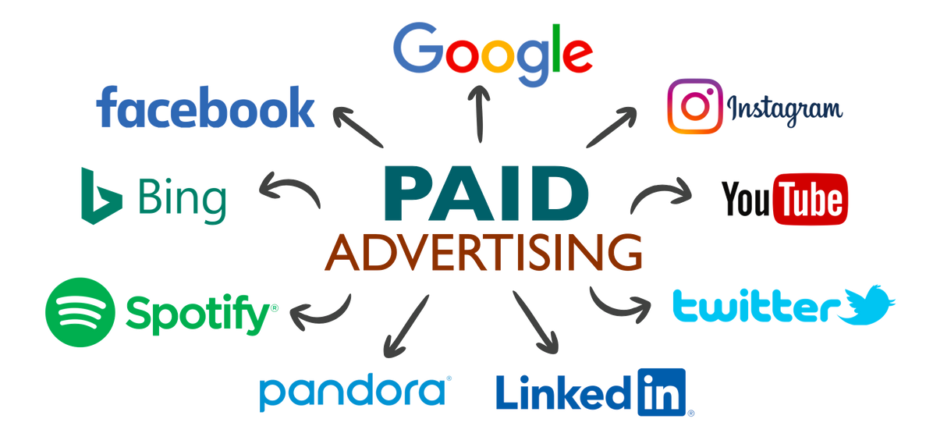
Paid Advertising
Paid Advertising
Invest in advertising campaigns on search engines (Google Ads) and social media platforms (Facebook Ads, Instagram Ads)
Google Ads:
Search Campaigns: $1,000 - $5,000 per month
Display Campaigns: $500 - $2,000 per month
Remarketing Campaigns: $500 - $2,000 per month
Social Media Advertising (FB Ads, Instagram Ads):
Facebook Ads: $500 - $3,000 per month
Instagram Ads: $500 - $3,000 per month
Combined Facebook and Instagram Ads: $1,000 - $6,000 per month
Total Monthly Budget Range: $2,000 - $10,000
(or more)

Slide 35
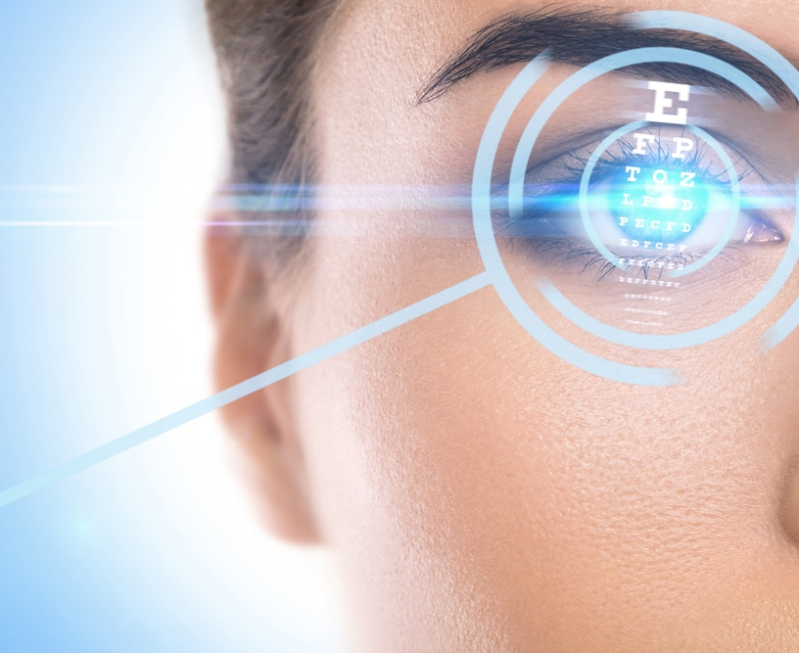
05
Conclusive Insights: Evaluating Outcomes and Forward Strategies

Slide 36
01
UI Enhancements
Keep the UI simple, clean and easy to navigate.
Add advanced features like chatbot, videos, sign-up forms to get more data and traffic on website
02
Social & Search Media
Enhance social media presence for both the business and Dr.Khosrof
Improve SEO
Summary
03
KPI
Optimize Ilovelasik.com, driving growth through targeted strategies and integrated Google Analytics tracking.
04
Marketing
Strategies
Sponsoring Ads will help drive traffic to the website and increase awareness.

Slide 37
In conclusion,
by implementing the advice mentioned in this research, "I Love Lasik" can position itself for success in the highly competitive healthcare market. The company can generate long-term growth and meet its goals of attracting more patients and growing revenue by regularly analyzing performance metrics, responding to changes in consumer behavior, and remaining current on industry trends.

Slide 38

THANK
YOU

